Slide 1
Big Data Biomedical Informatics | 12 SEP 2024
BIOF3001
Workshop 2 – Analysis and Visualization of Big Data in Python
Yongtao Ye, Tommy Lam
yytao@connect.hku.hk, ttylam@hku.hk
School of Public Health
The University of Hong Kong

Slide 2
How to explore a big biomedical data?
A number of variables associated with different observations have been extensively studied for a particular biomedical problem.

Slide 3
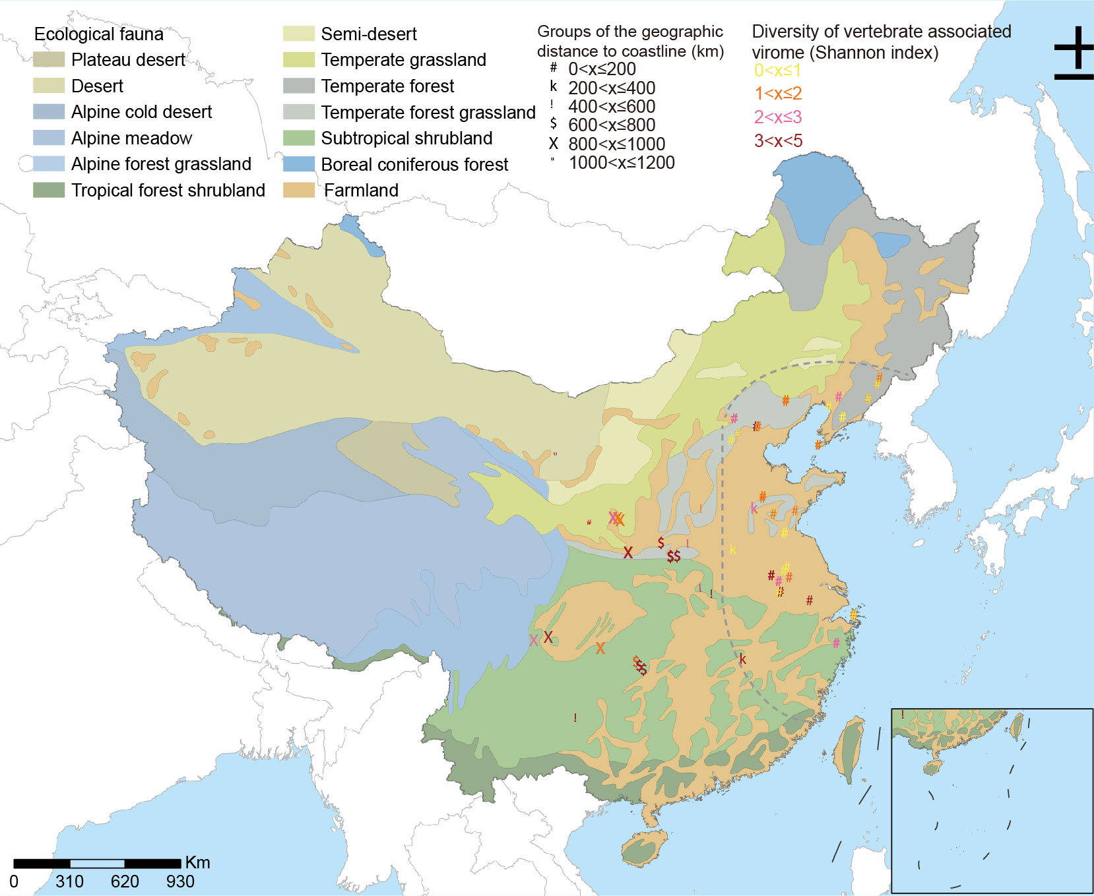
Ecoclimate drivers shape virome diversity in a globally invasive tick species. The ISME Journal. (2024).
Multiple metagenomic samples in different locations are sequenced to explore the association between virome diversity and ecoclimate factors.

Slide 4
How to explore a big biomedical data?
A tutorial to explore how to analysis a metagenomic dataset.
Dimensionality reduction
Multivariable associations and regressions

Slide 5
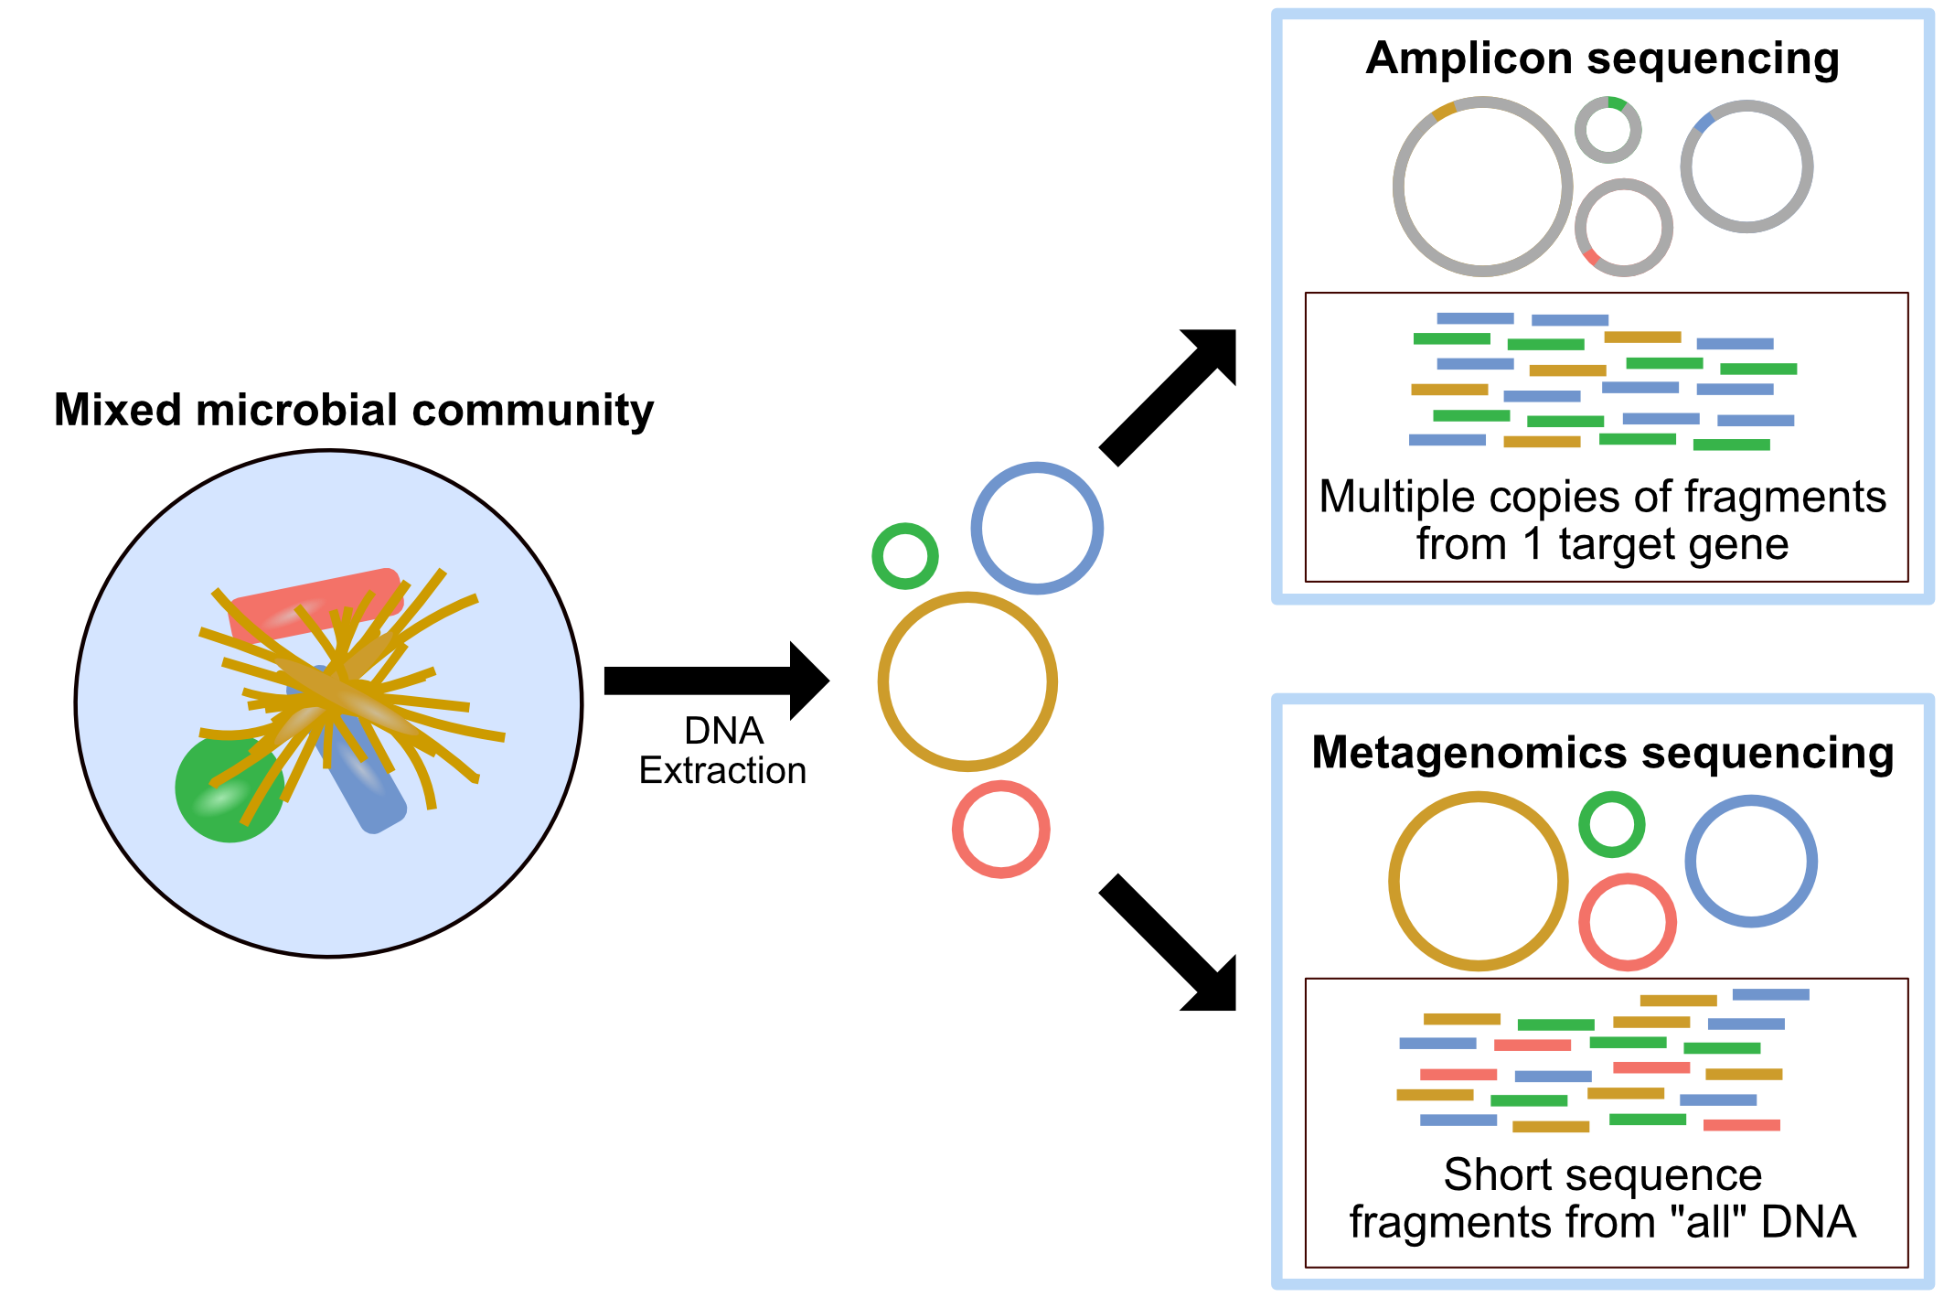
Metagenomic sequencing

Slide 6
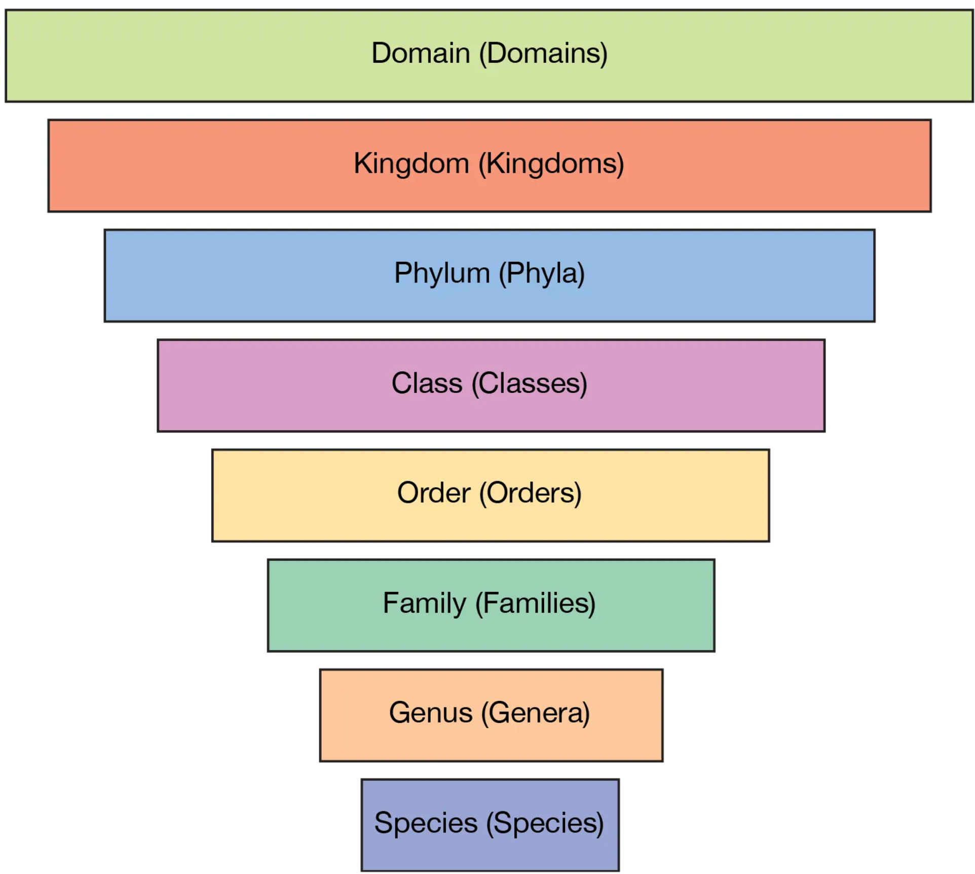
Taxonomy classification
Abundance in a metagenomic sample

Slide 7
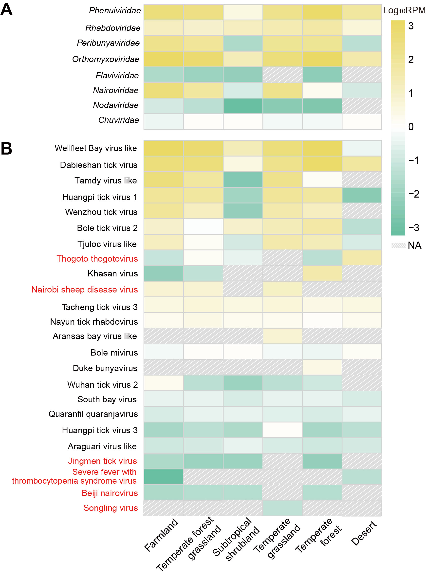
Heatmaps show average abundance of each vertebrate-associated viral family (A) and viral species (B) in different ecotypes.
Ecotype as a specific environmental condition associated with multiple ecoclimate factors.

Slide 8
Are viral abundance and composition different in different ecotypes?
A hypothesis is a significant association between them.

Slide 9
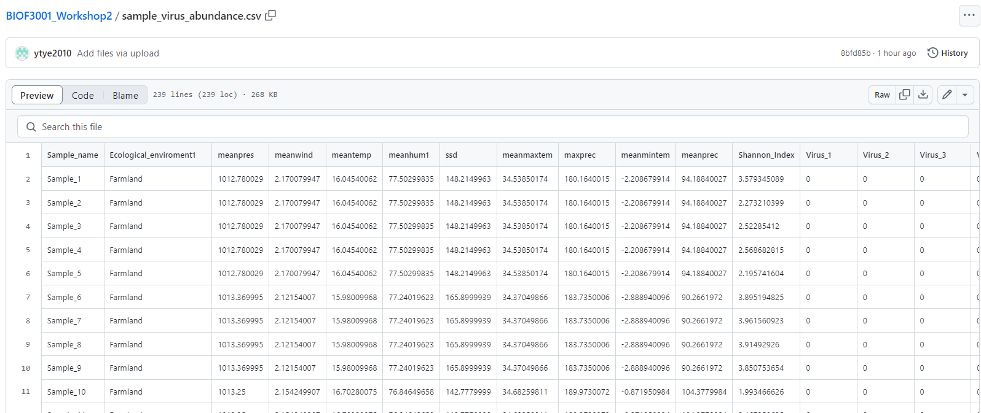
Dataset
https://github.com/id-bioinfo/BIOF3001_Workshop2/blob/main/sample_virus_abundance.csv
Or Moodle

Slide 10
IDE
Recommend to use google colab, an online notebook with most packages already installed.
- Any platform works with python (Visual Studio Code, PyCharm, Sublime Text), up to you.
https://colab.research.google.com/

Slide 11
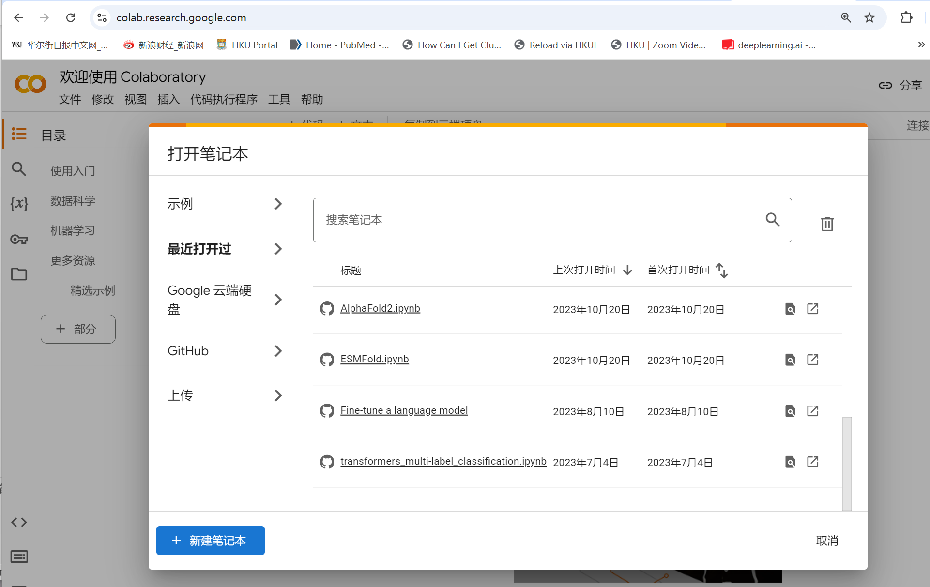
Create a new notebook
New notebook

Slide 12
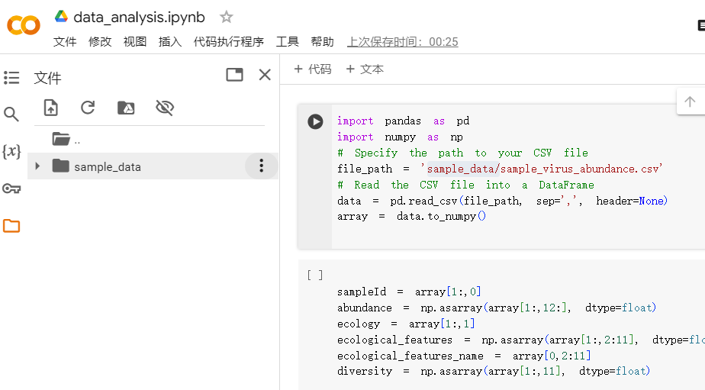
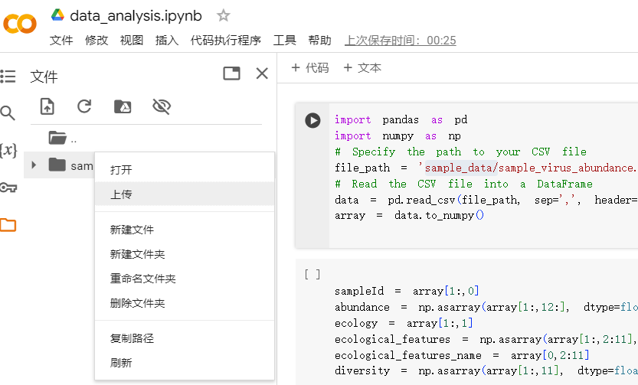
Upload the CSV data file
upload

Slide 13
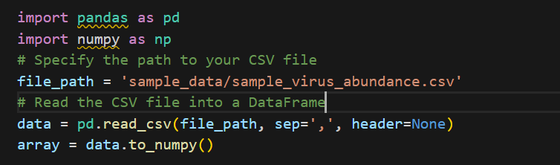
Read the dataset, a CSV file
A script is provided in github and Moodle.

Slide 14
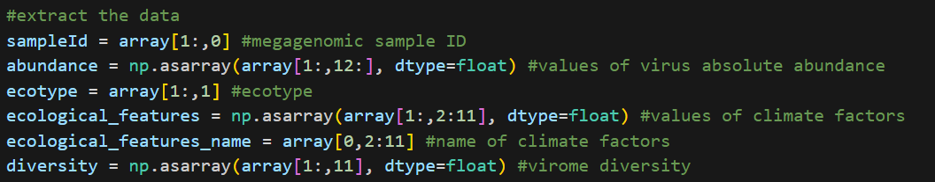
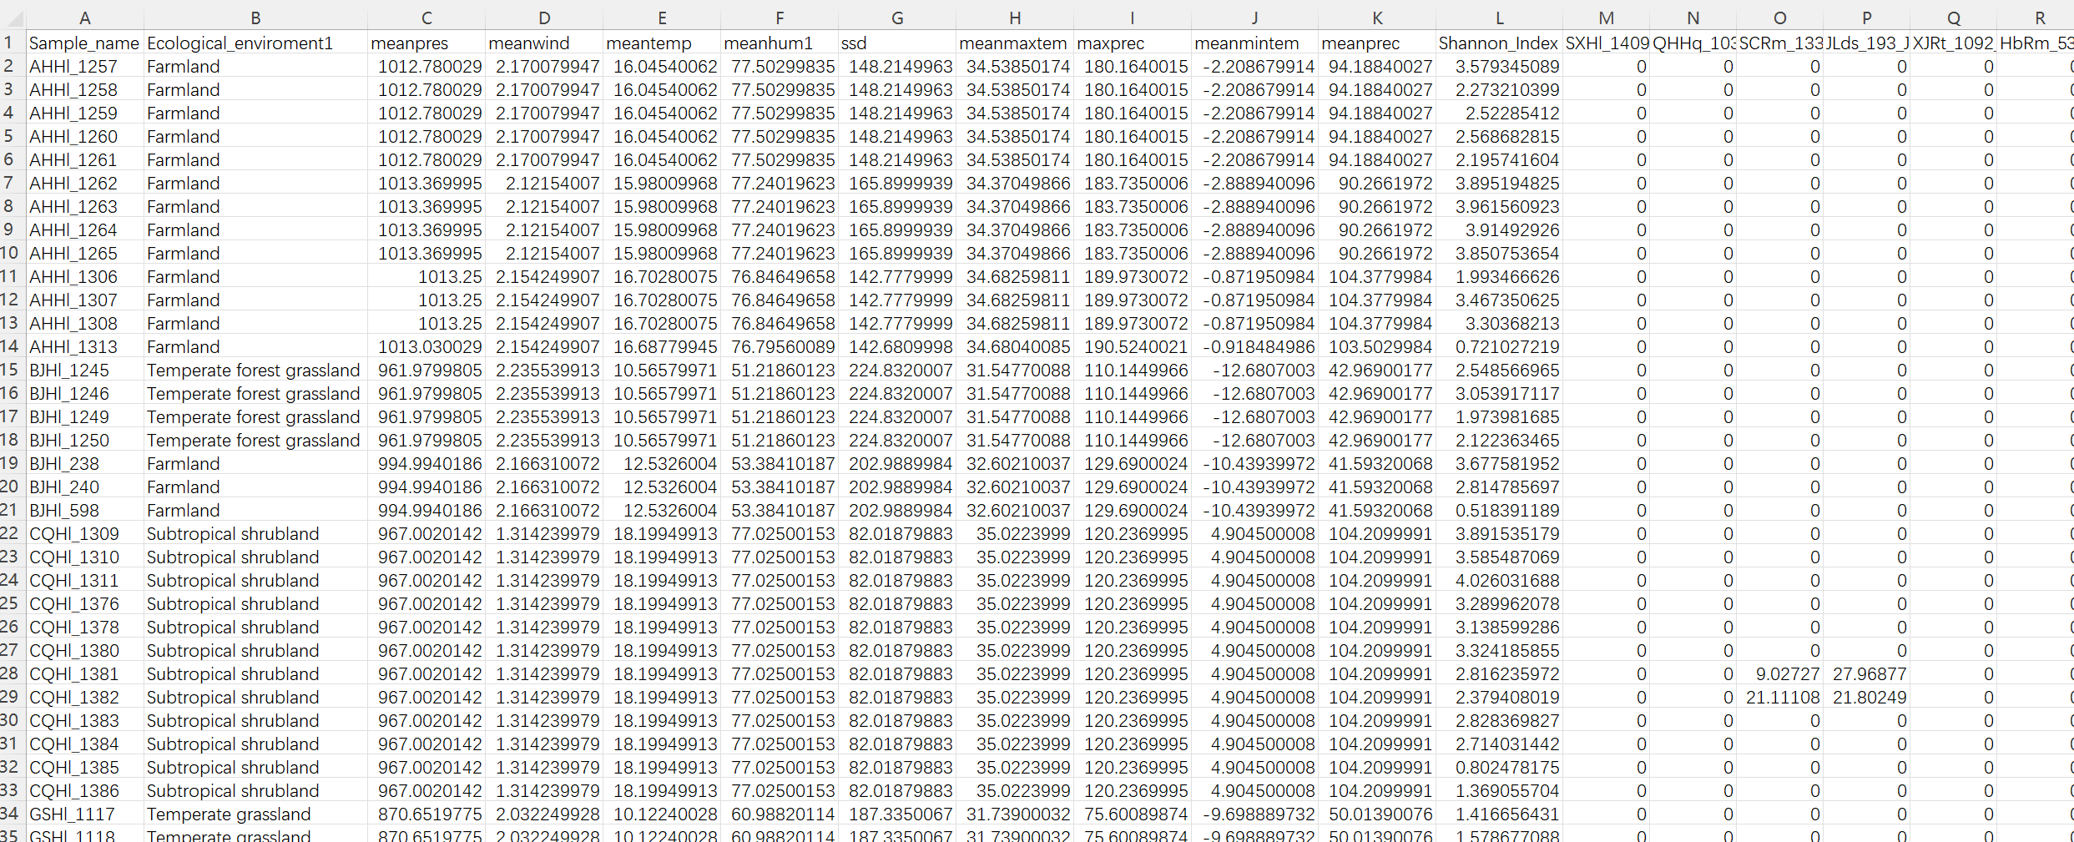
Extract the variables and values for this tutorial

Slide 15
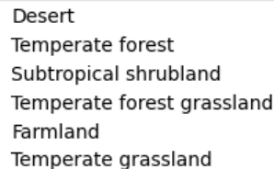
Extract the variables and values for this tutorial
9 climate factors | Id
air pressure | meanpres
wind speed | meanwind
temperature | meantemp
relative humidity | meanhum1
sunshine duration | ssd
max temperature | meanmaxtem
max precipitation | maxprec
min temperature | meanmintem
precipitation | meanprec
6 ecotypes

Slide 16
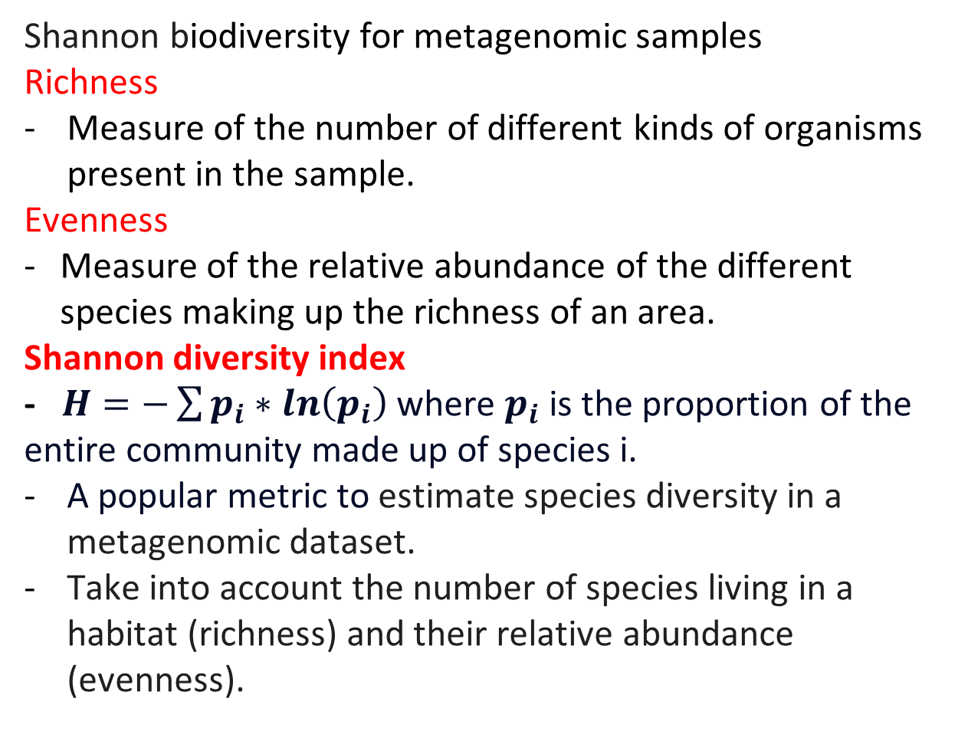
Extract the variables and values for this tutorial
Shannon biodiversity for metagenomic samples
Richness
Measure of the number of different kinds of organisms present in the sample.
Evenness
Measure of the relative abundance of the different species making up the richness of an area.
Shannon diversity index
- $H=−\sum{p_{i}∗ln\left(p_{i}\right)}$ where $p_{i}$is the proportion of the entire community made up of species i.
A popular metric to estimate species diversity in a metagenomic dataset.
Take into account the number of species living in a habitat (richness) and their relative abundance (evenness).

Slide 17
Dimensionality reduction

Slide 18
Dimensionality reduction (DR)
Projecting the data from high-dimensional space to lower dimensional space.
Principal component analysis (PCA)
linearly transformed onto a new coordinate system such that the directions (principal components) capturing the largest variation in the data can be easily identified.
Linear discriminant analysis (LDA)
related to analysis of variance and regression analysis
attempt to express one dependent variable as a linear combination of other features or measurements.

Slide 19
scikit-learn
A community project provides a great number of packages for machine learning.
This project was started in 2007 as a Google Summer of Code project.
from sklearn.decomposition import PCA
from sklearn.discriminant_analysis import LinearDiscriminantAnalysis

Slide 20
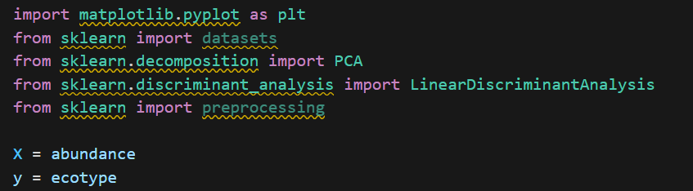
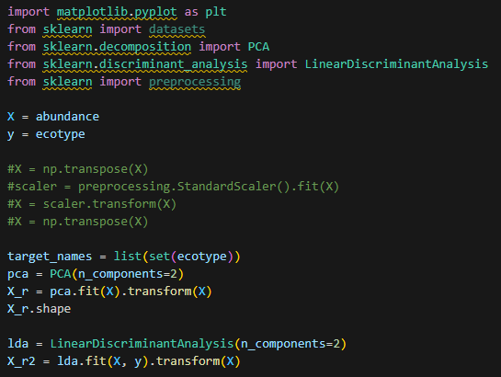
PCA and LDA
Load packages
Set the data
Run PCA and LDA

Slide 21
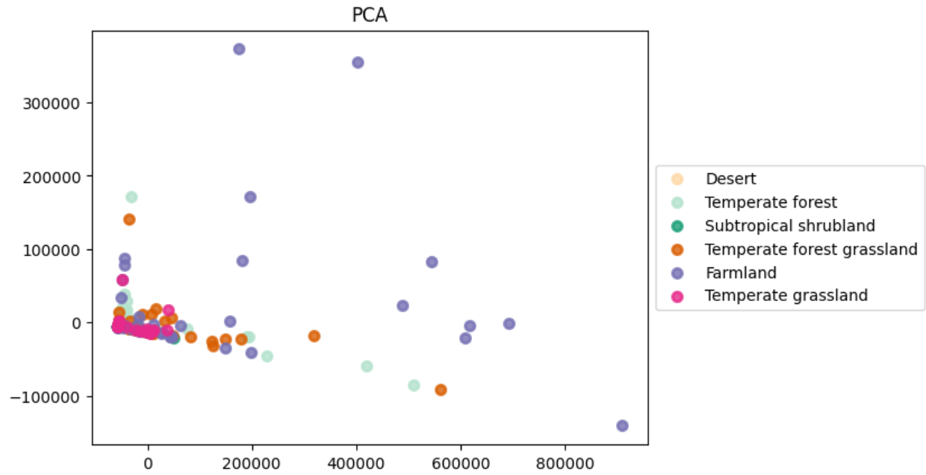
PCA
explained variance ratio (PCA first two components): [0.88467346 0.08685128]

Slide 22
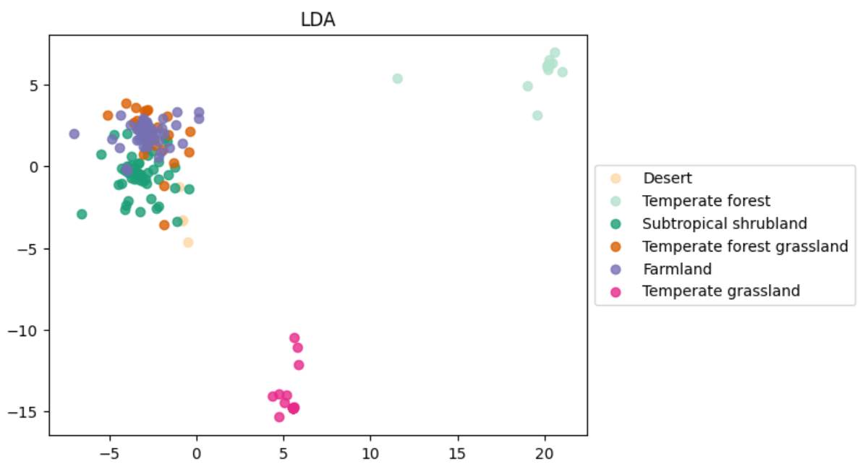
LDA
explained variance ratio (LDA first two components): [0.45709294 0.27094965]

Slide 23
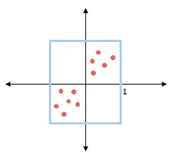
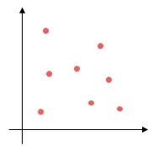
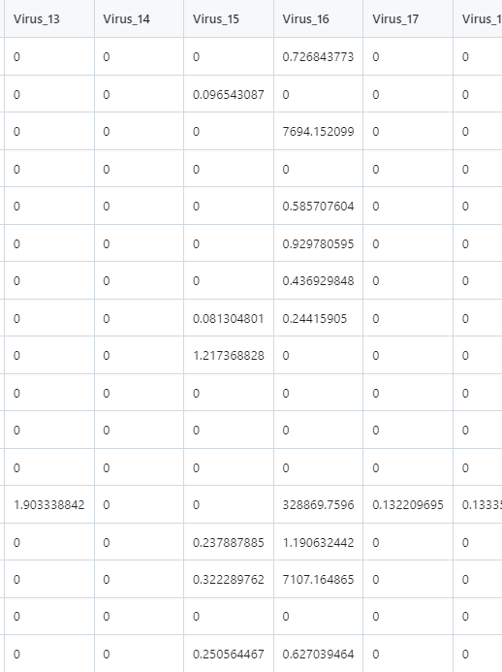
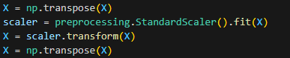
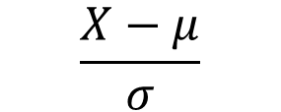
PCA and LDA with data standardization
$$\frac{X−μ}{σ}$$
standardization along columns
standardization along rows

Slide 24
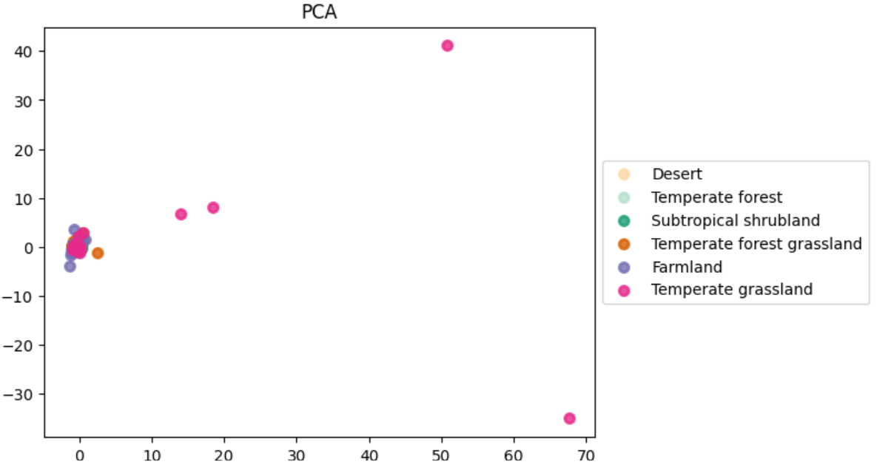
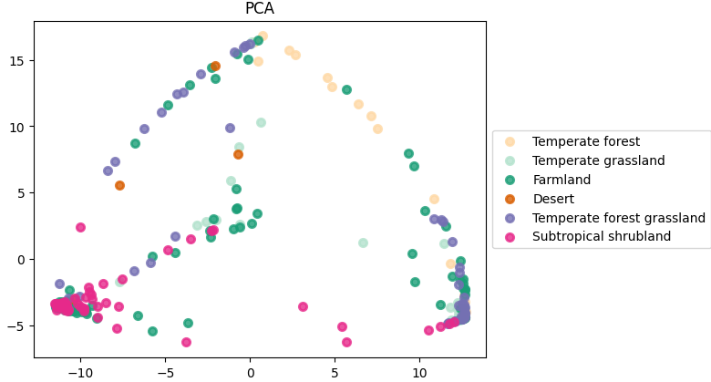
PCA
explained variance ratio
[0.88467346 0.08685128]
standardization along columns
standardization along rows
explained variance ratio
[0.11085358 0.04451011]
explained variance ratio
[0.50033645 0.20243533]

Slide 25
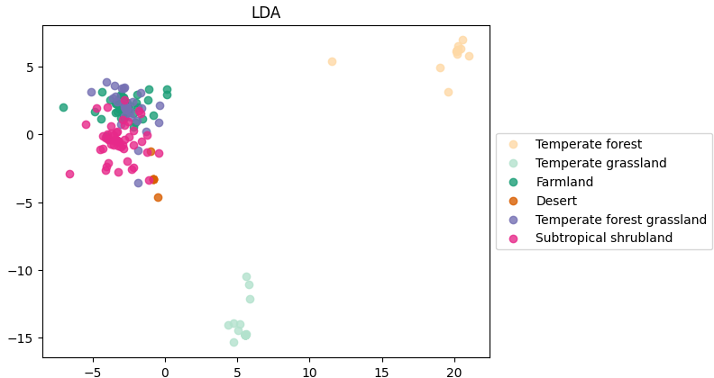
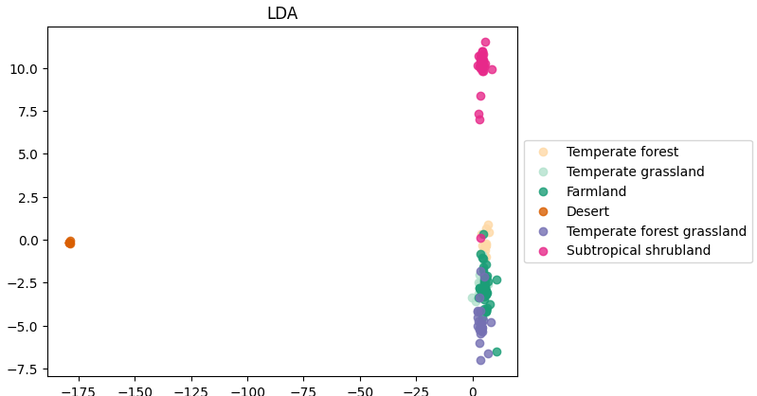
LDA
explained variance ratio
[0.45709294 0.27094965]
standardization along columns
standardization along rows
explained variance ratio
[0.45709294 0.27094965]
explained variance ratio
[0.94389184 0.03719273]

Slide 26
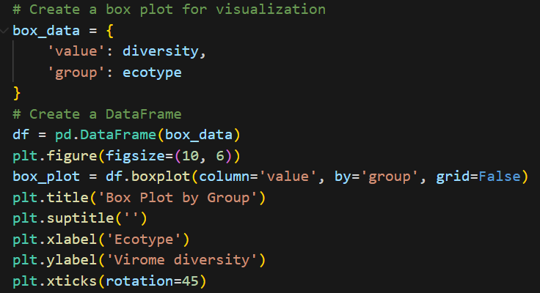
Different virome patterns in different ecotypes
Virome diversity is measured by Shannon Index.

Slide 27
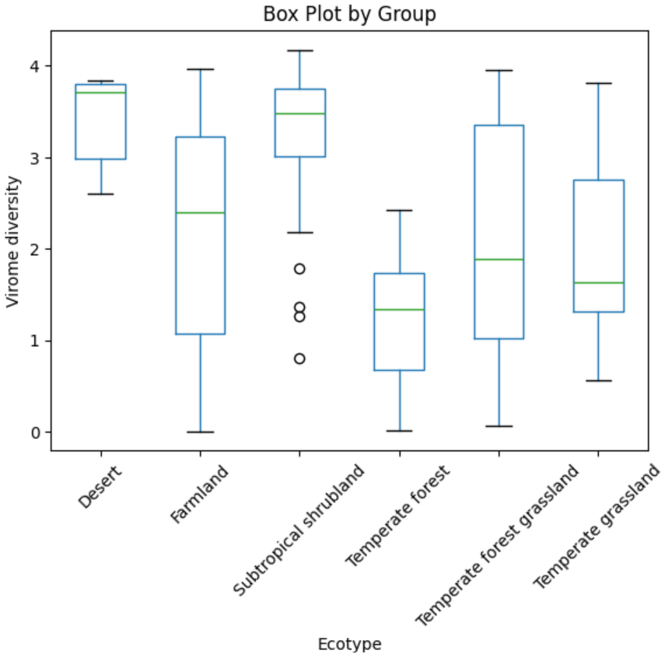
Different virome diversity in different ecotypes

Slide 28
Different virome diversity in different ecotypes
A two-sample test is to determine whether the difference between these two populations is statistically significant.
Student's t-test requires normal distribution assumption.
Wilcoxon rank-sum test does not require the normal distribution assumption.

Slide 29
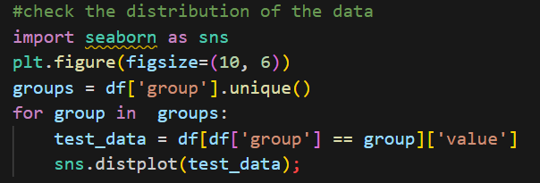
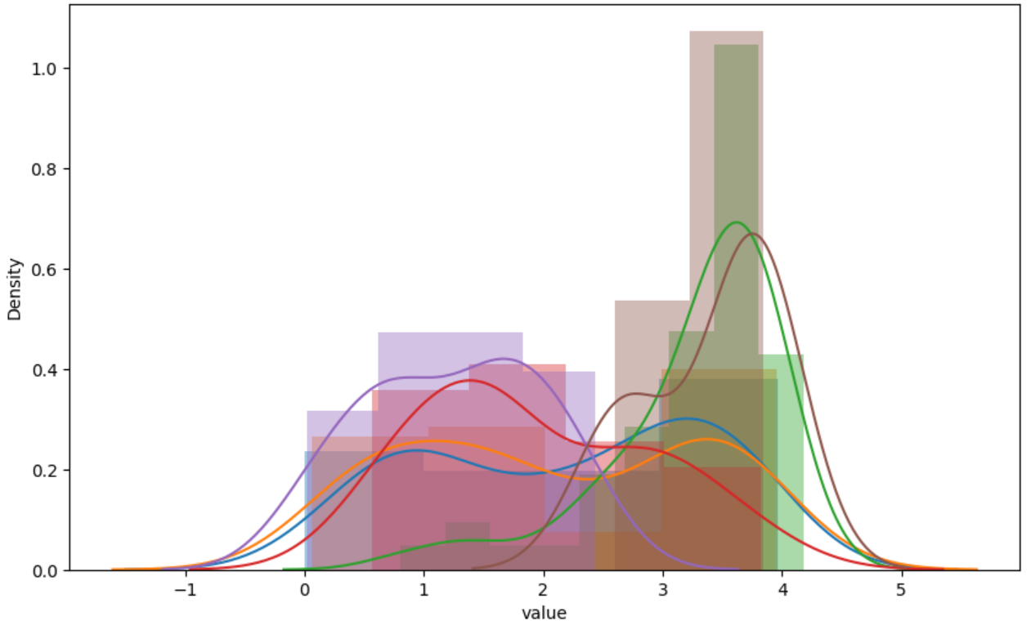
Distribution checking
Checking data distribution in each ecotype

Slide 30
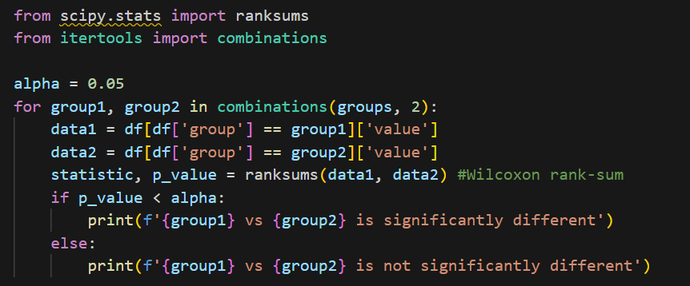
Wilcoxon rank-sum test
Group 1 | Group 2 | significantly different
Farmland | Temperate forest grassland | No
Farmland | Subtropical shrubland | Yes
Farmland | Temperate grassland | No
Farmland | Temperate forest | Yes
Farmland | Desert | Yes
Temperate forest grassland | Subtropical shrubland | Yes
Temperate forest grassland | Temperate grassland | No
Temperate forest grassland | Temperate forest | Yes
Temperate forest grassland | Desert | Yes
Subtropical shrubland | Temperate grassland | Yes
Subtropical shrubland | Temperate forest | Yes
Subtropical shrubland | Desert | No
Temperate grassland | Temperate forest | Yes
Temperate grassland | Desert | Yes
Temperate forest | Desert | Yes
Farmland and Grassland with similar environmental condition?
Both with high temperature

Slide 31
Multivariable associations and regressions

Slide 32
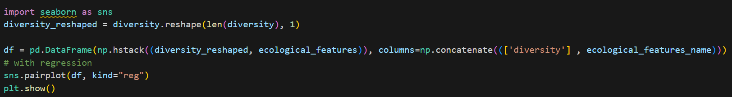
Multivariate association
What ecoclimate factors do contribute to virome diversity?

Slide 33
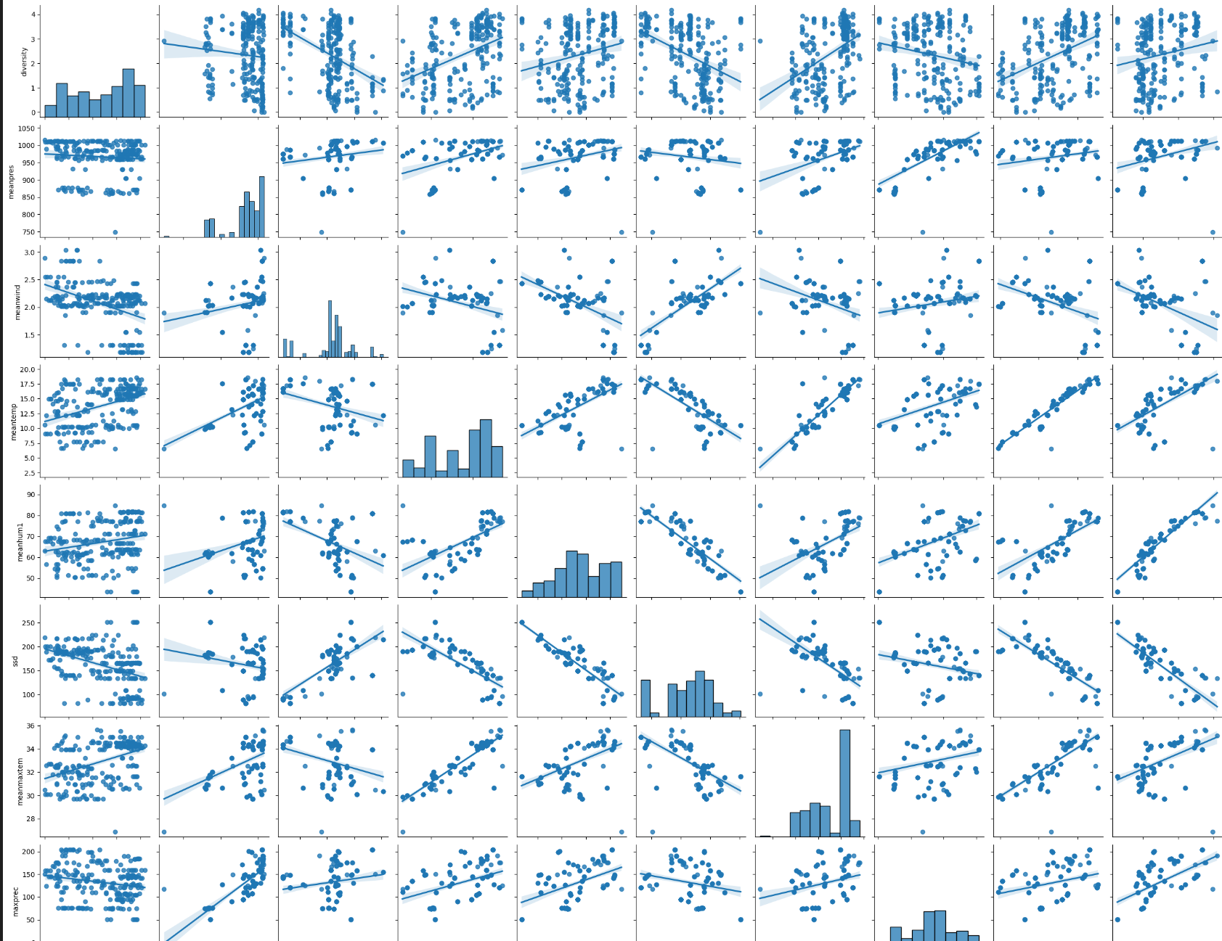
Multivariate association
air pressure
temperature
sunshine duration
max precipitation
precipitation
diversity
wind speed
relative humidity
max temperature
min temperature

Slide 34
Multivariate association
air pressure
temperature
sunshine duration
max precipitation
precipitation
diversity
wind speed
relative humidity
max temperature
min temperature
collinear effects

Slide 35
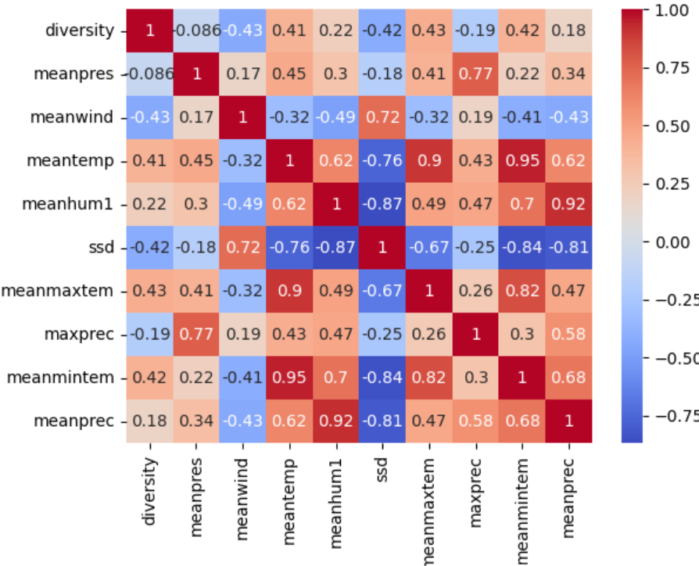
Multivariate correlation
What ecoclimate factors do contribute to virome diversity?

Slide 36
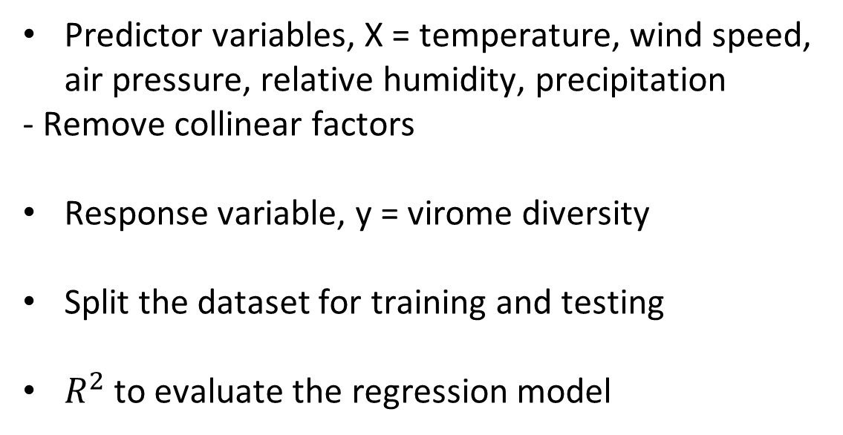
Multivariate regression
What ecoclimate factors do contribute to virome diversity?
Predictor variables, X = temperature, wind speed, air pressure, relative humidity, precipitation
- Remove collinear factors
Response variable, y = virome diversity
Split the dataset for training and testing
$R^{2}$to evaluate the regression model

Slide 37
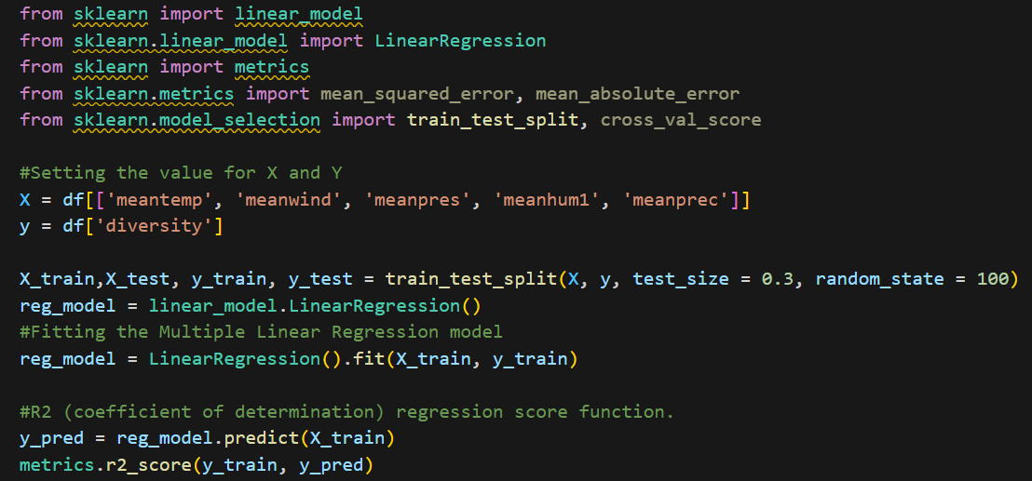
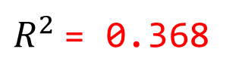
Multivariate regression in training
What ecoclimate factors do contribute to virome diversity?
$R^{2}$= 0.368

Slide 38
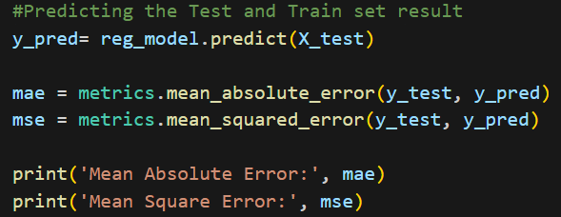
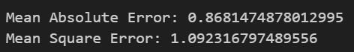
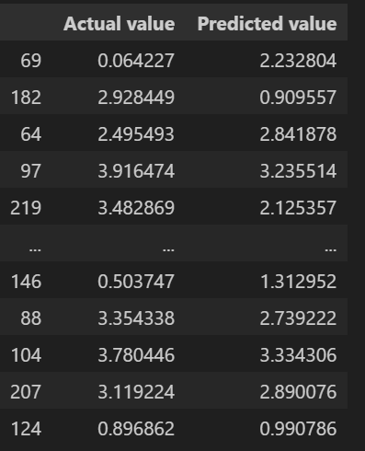
Multivariate regression in testing
What ecoclimate factors do contribute to virome diversity?

Slide 39
Multivariate regression
What ecoclimate factors do contribute to virome diversity?
A multivariate regression could reflect an association between virome diversity and ecoclimate factors.
But a simple linear model is not good enough.
More complicated machine (deep) learning models may help to model such associations (next lecture).

Slide 40
Hands on trial

Slide 41
Scenario
Though Farmland is significantly different from Desert, it is overlapping/close with Desert using LDA.
A 2D projection from high dimensions to low may miss information.
Group 1 | Group 2 | significantly diffreent
Farmland | Temperate forest grassland | No
Farmland | Subtropical shrubland | Yes
Farmland | Temperate grassland | No
Farmland | Temperate forest | Yes
Farmland | Desert | Yes
Temperate forest grassland | Subtropical shrubland | Yes
Temperate forest grassland | Temperate grassland | No
Temperate forest grassland | Temperate forest | Yes
Temperate forest grassland | Desert | Yes
Subtropical shrubland | Temperate grassland | Yes
Subtropical shrubland | Temperate forest | Yes
Subtropical shrubland | Desert | No
Temperate grassland | Temperate forest | Yes
Temperate grassland | Desert | Yes
Temperate forest | Desert | Yes

Slide 42
Task
Can we improve the clustering methods to sperate them better?
- Linear or non-linear RD method?
Data pre-processing?
scikit-learn

